Slide 1
Module 13 Describing Moving Image Resources
RDA Training University of Nevada, Las Vegas
May 2013
Notes:
This module is intended to cover special procedures for audio recordings that differ from books. We’ve already covered thoroughly how to describe a book. We won’t go over all that again, exept to note when you do the same thing for an audio recording.

Slide 2
Please log in to RDA
Please feel free to sign up later for a month’s free access so you can practice (see handout)
Notes:
From now on, as I show slides of RDA, please feel free to go ahead and look yourself in the Toolkit.

Slide 3
Mode of Issuance
Single unit monograph?
Single DVD
Streaming video file
Multipart monograph?
A film on two discs
Serial?
Integrating resource?
Notes:
This module only covers monographs.

Slide 4
Basis for Identification RDA 2.1
Single unit monograph
The item itself
Multipart monograph
The first unit
Notes:
This module only covers monographs.

Slide 5
Preferred Source of Information RDA 2.2.2.3
Choose, in the part chosen as the basis for identification, either
the title screen(s) or frame(s)
alternative
a label bearing a title that is permanently printed on or affixed to the resource
or
embedded metadata in textual form
If none of these is available, use
another source forming part of the resource itself, preferring a source where the information is formally presented
Notes:
Title screen is the preferred source. Alternatively you may use a label on the disc. If the label does not include the information you need, you can go to another source forming part of the resource itself, e.g., the container.
NOTE: Title frames can come from either the beginning or the end of the resource, or both.

Slide 6
Kubrik: Preferred source Title frames

Slide 7
Kubrik: Preferred source Title frames

Slide 8
Kubrik: Preferred source Title frames

Slide 9
Kubrik: Preferred source Title frames

Slide 10
Kubrik: Preferred source Title frames

Slide 11
Kubrik: Preferred source Title frames

Slide 12
Kubrik: Preferred source Title frames

Slide 13
Kubrik: Preferred source Title frames

Slide 14
Kubrik: Preferred source Title frames

Slide 15
Kubrik: Preferred source Title frames

Slide 16
Kubrik: Preferred source Title frames

Slide 17
Kubrik: Preferred source Title frames

Slide 18
Kubrik: Alternative preferred source

Slide 19
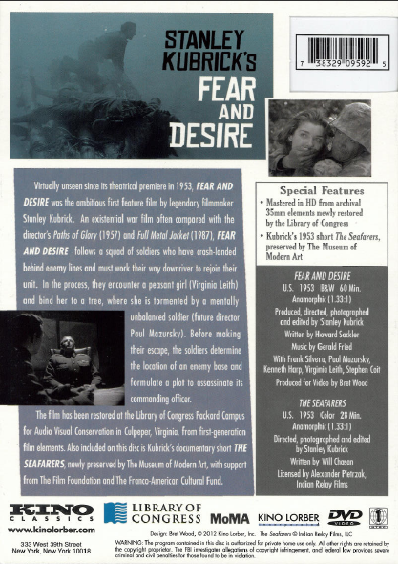
Kubrik: other source

Slide 20
Temple: Preferred source Title frames side 1
Notes:
Note this one is a complation, more than one film on the disc.

Slide 21
Temple: Preferred source Title frames side 1

Slide 22
Temple: Preferred source Title frames side 1

Slide 23
Temple: Preferred source Title frames side 1

Slide 24
Temple: Preferred source Title frames side 1

Slide 25
Temple: Preferred source Title frames side 1

Slide 26
Temple: Preferred source Title frames side 1

Slide 27
Temple: Preferred source Title frames side 1

Slide 28
Temple: Preferred source Title frames side 1

Slide 29
Temple: Preferred source Title frames side 1

Slide 30
Temple: Preferred source Title frames side 1

Slide 31
Temple: Preferred source Title frames side 1

Slide 32
Temple: Preferred source Title frames side 1

Slide 33
Temple: Preferred source Title frames side 1

Slide 34
Temple: Preferred source Title frames side 2 (collective title)

Slide 35
Temple: Preferred source Title frames side 2 (film 1)

Slide 36
Temple: Preferred source Title frames side 2 (film 2)

Slide 37
Temple: Preferred source Title frames side 2 (film 2)

Slide 38
Temple: Preferred source Title frames side 2 (film 2)

Slide 39
Temple: Preferred source Title frames side 2 (film 2)

Slide 40
Temple: Preferred source Title frames side 2 (film 3)

Slide 41
Temple: Preferred source Title frames side 2 (film 3)

Slide 42
Temple: Preferred source Title frames side 2 (film 3)

Slide 43
Temple: Preferred source Title frames side 2 (film 4)

Slide 44
Temple: Preferred source Title frames side 2 (film 4)

Slide 45
Temple: Preferred source Title frames side 2 (film 4)

Slide 46
Temple: Preferred source Title frames side 2 (film 5)

Slide 47
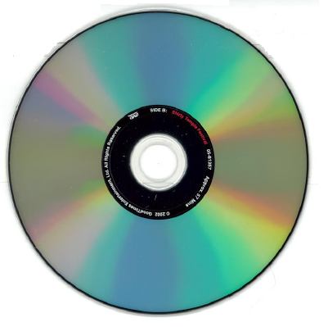
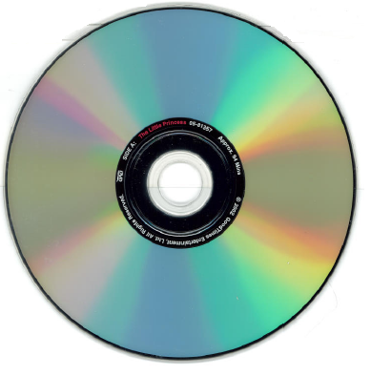
Temple: Alternative preferred source

Slide 48
Temple: other source
Notes:
OK, now we have all our evidence out.

Slide 49
This Presentation is available at
http://net.lib.byu.edu/~catalog/people/rlm/RDALV201305/index.htm
For further information
contact Robert L. Maxwell
robert_maxwell@byu.edu

